Slide 1
SOCIAL MEDIA MASTERCLASS
Welcome

Slide 2
WHY SOCIAL MEDIA ?

Slide 3
Some of the reasons
You get to meet and connect with new people
There are a lot of people on social media, that means lots of possibilities
You only have to say your message once, and it goes to many people
You meet people who are already prepared to do business
You get to do your business online, it saves money.
There is an opportunity to grow my business.
I don’t have to put in much effort

Slide 4
FAcebook
Current known statistics – specific in zimbabwe
Facebook recorded 1, 799, 800 active Facebook users in Zimbabwe. This report is from February 2023
This number adds up to 9.4% of the entire Facebook community
THIS RESEARCH HAS BEEN DONE TO SHOW THAT THERE ARE A LOT OF ZIMBABWEANS ON FACEBOOK AND IT’S A PROFITABLE IDEA TO TARGET ON REACHING TO THIS RICH MARKET

Slide 5
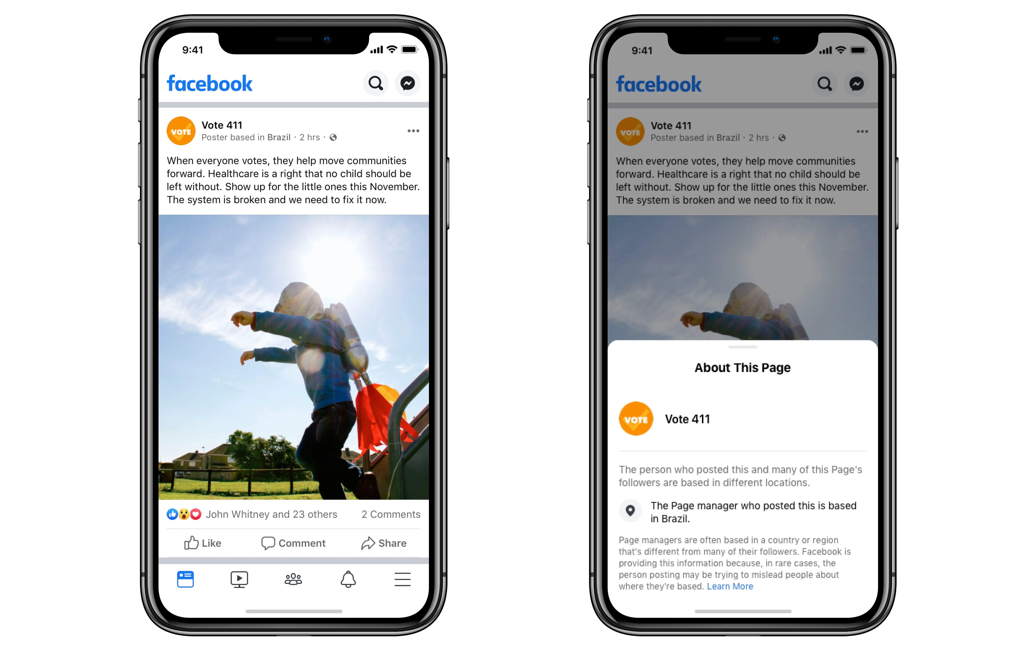
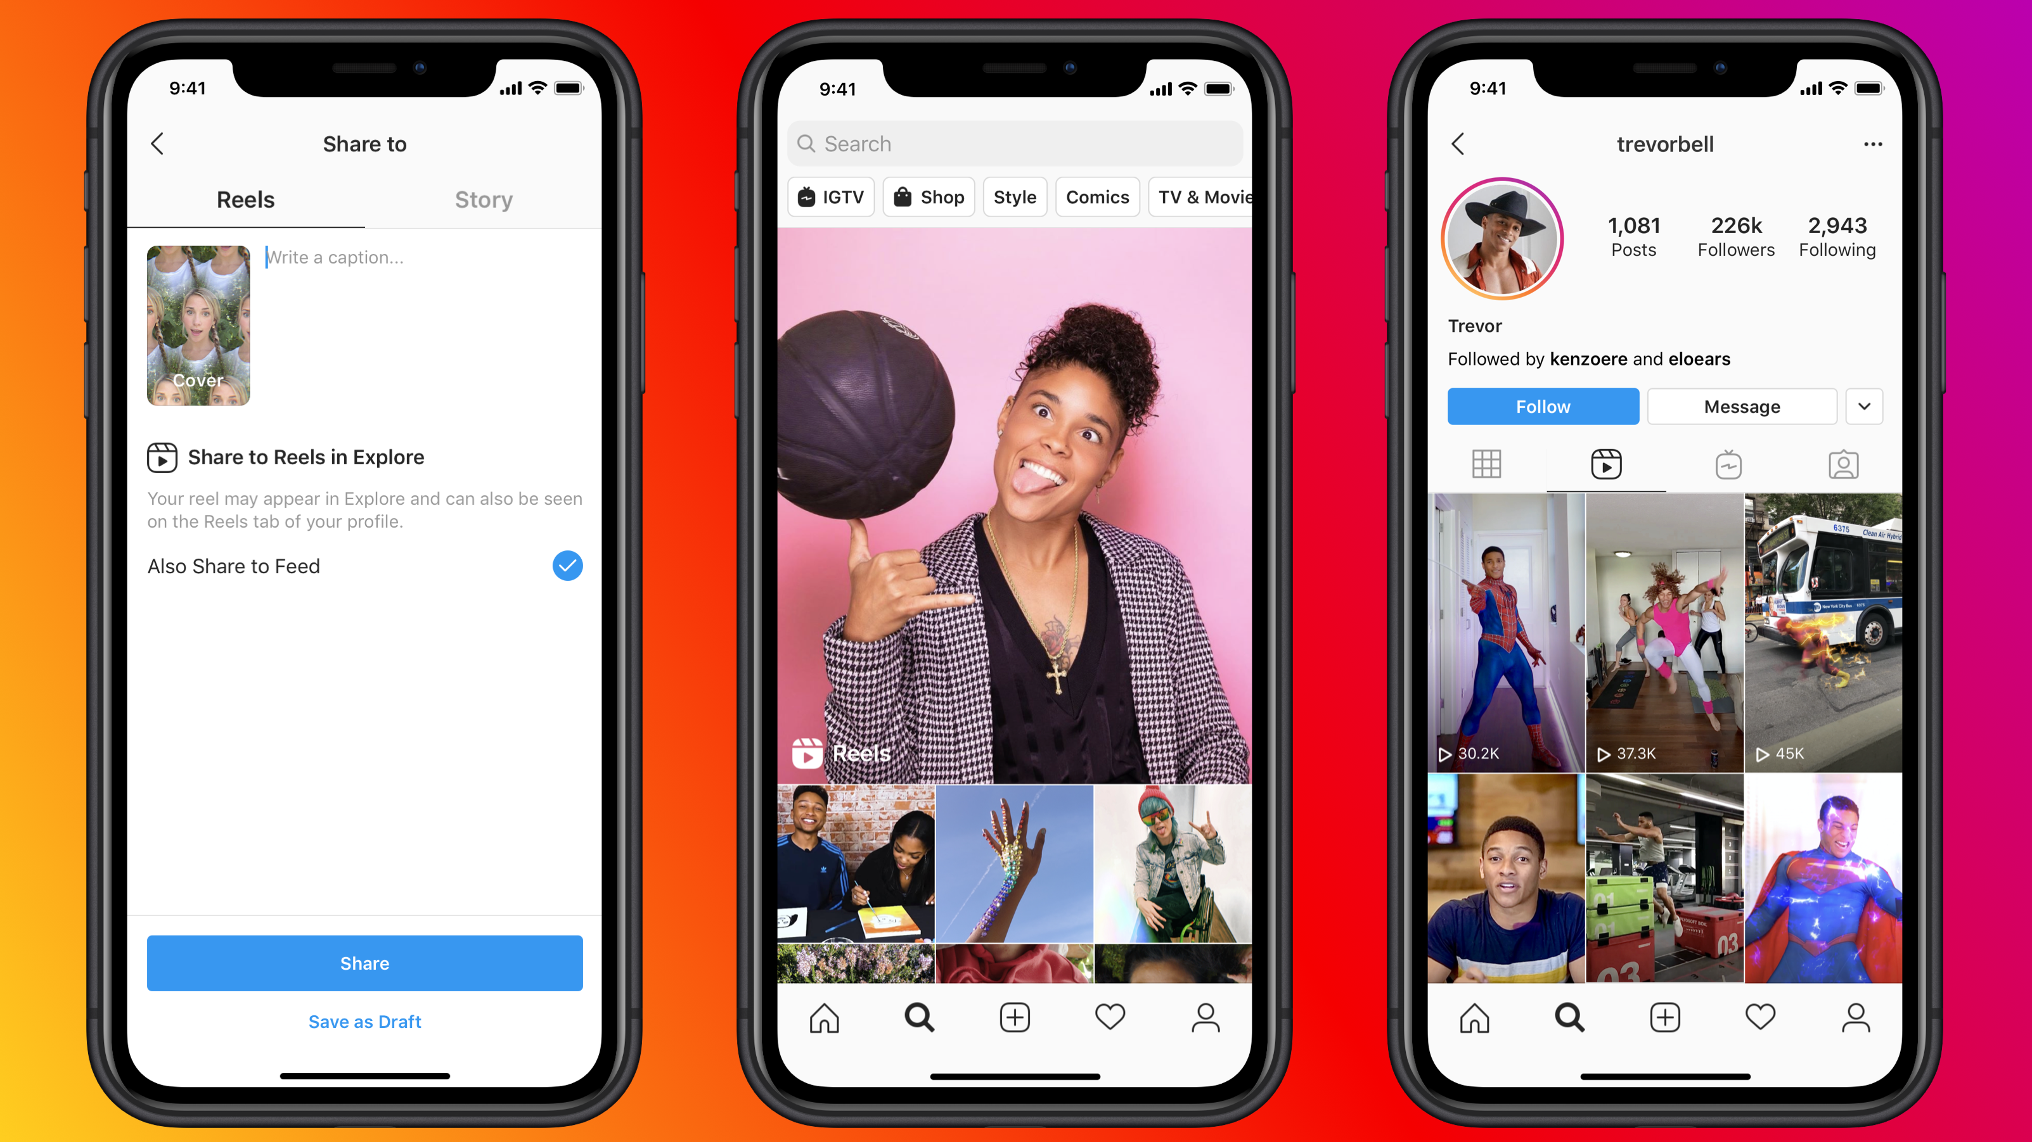
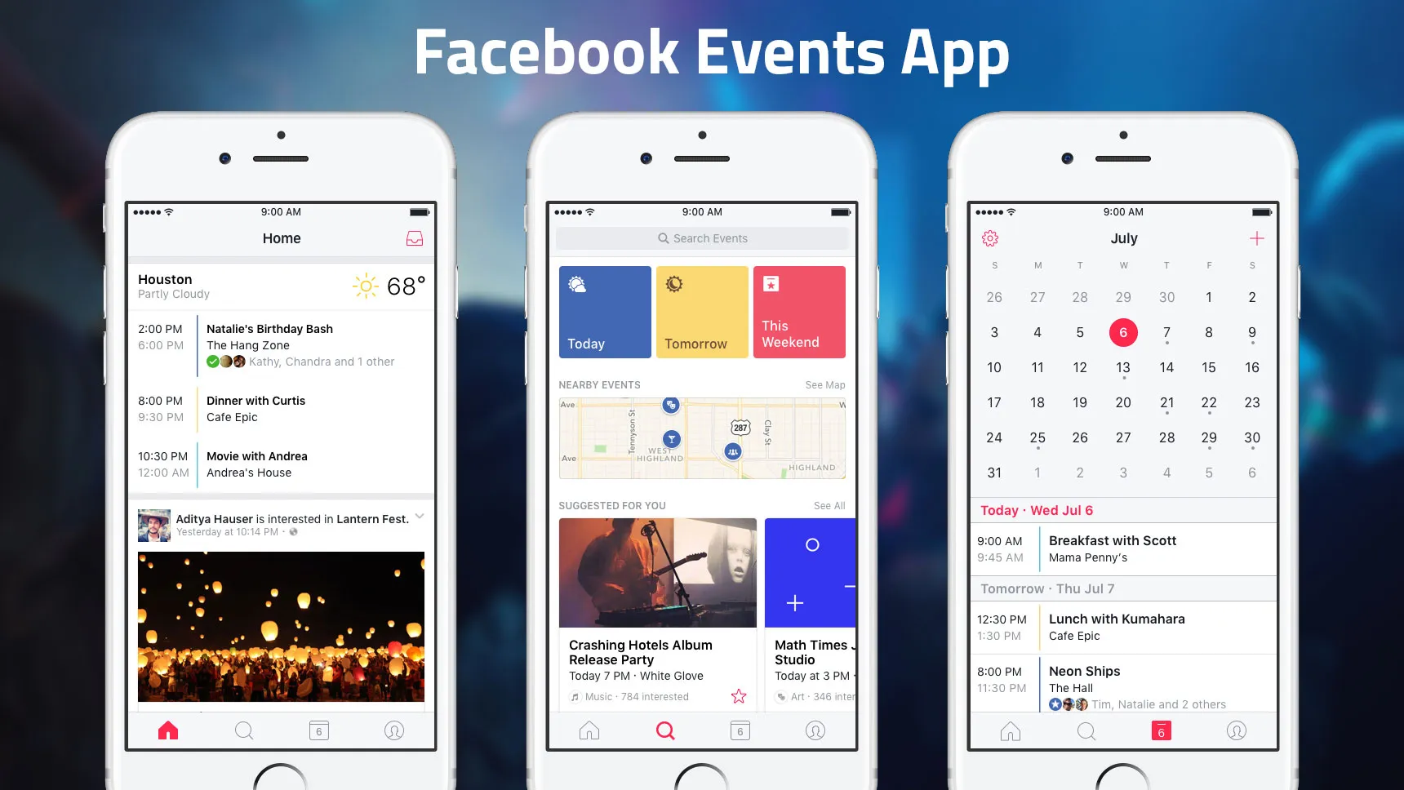
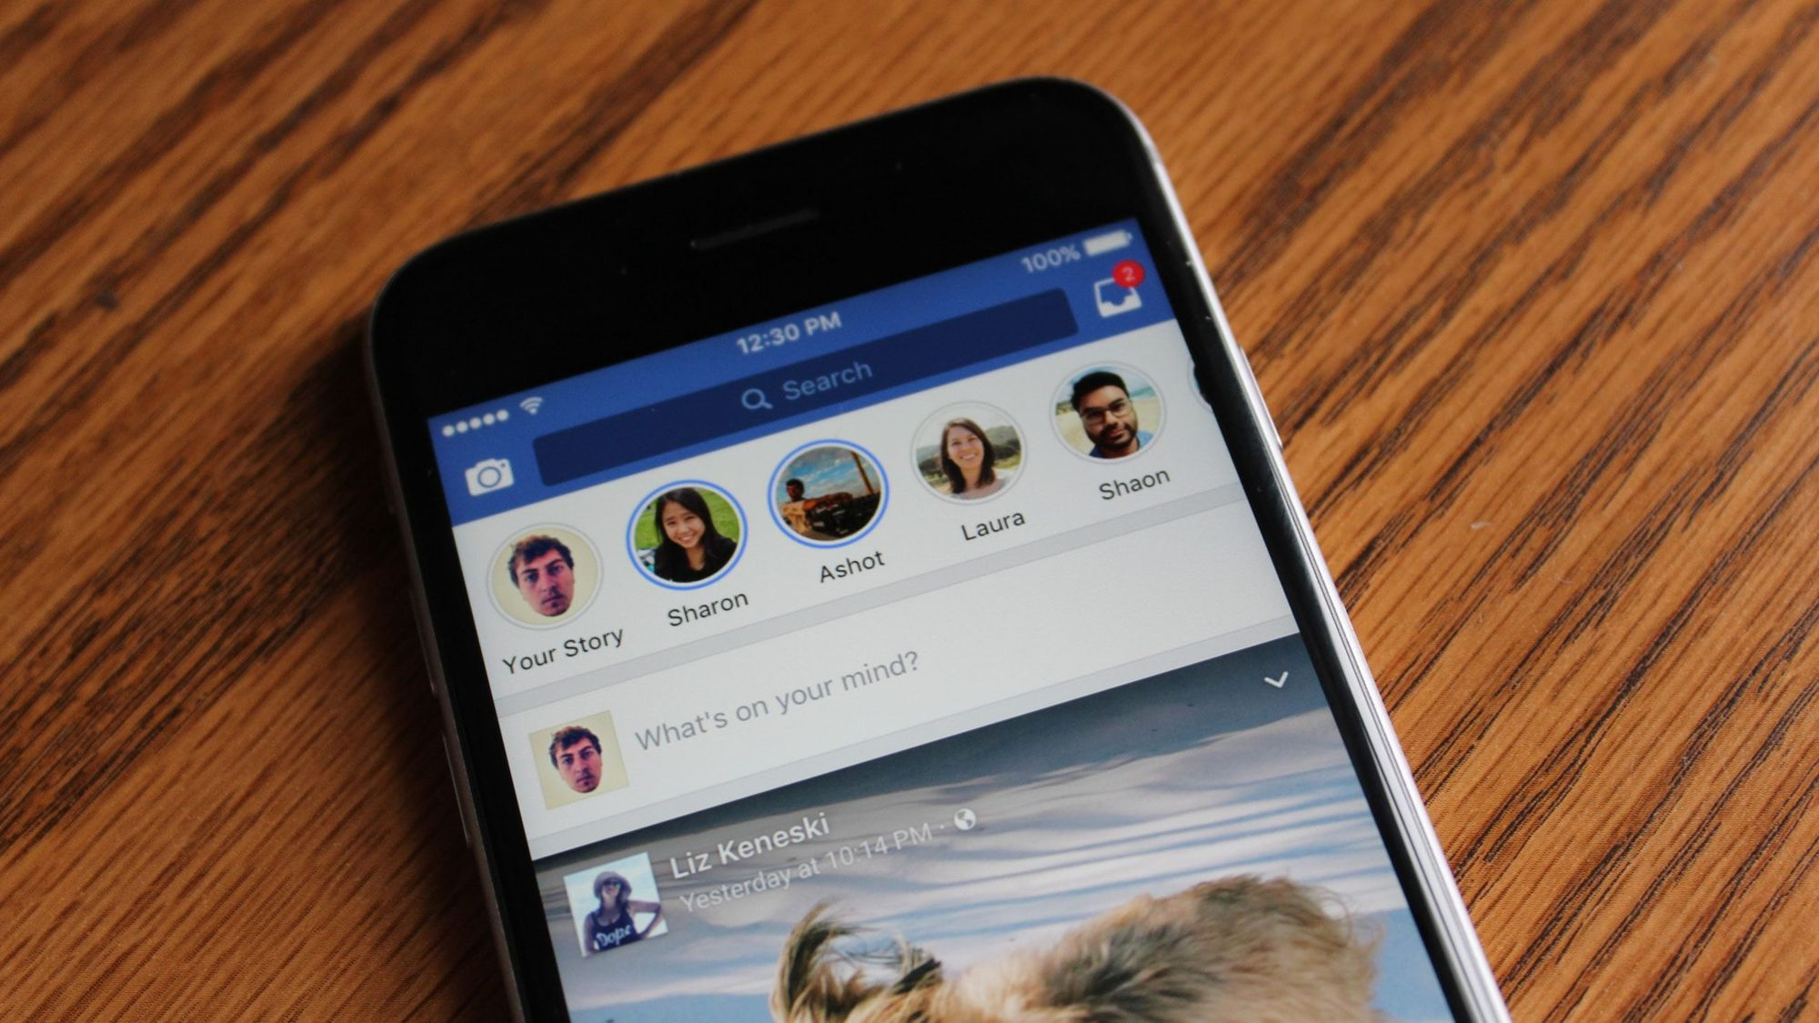
Areas to focus on
Reels
Stories
Posts
Events

Slide 6
Reels
Short, precise and informative video
Designed to grab viewers attention and make them focus more on your brand
They have a maximum limit of 90 seconds / 1 minute 30 seconds
The best way to use reels is to tell a short but interesting story about your brand or some product you will be advertising.
This is were you make people fall in love with your products or services

Slide 7
stories
Stories only have the disadvantage of disappearing after 24hrs
They are similar to WhatsApp statuses
For this reason, stories are meant to portray a singular message that is short and precise.
Talk about the current promotions that you are running
Talk about your best products or services that instantly catches people’s attention
Don’t bore your viewers with a lot of information here

Slide 8
posts
Posts on the other hand, they stay for as long as your Facebook page is active.
They don’t go anywhere, so do not post content that has damaging effect on your brand.
You should always be consistent on posting because of the following reasons:
When people visit your page, they want to know if the page is legit, because most of the other pages on Facebook are used by scammers.
When people visit your page, they go through your content in attempt to know more about your business.
People will go through your page looking for helpful information
Etc.

Slide 9
Deeper topics TO BE EXPLORED IN OTHER PRESENTATIONS
Events on Facebook
Live videos on Facebook
Types of content
Color psychology

Slide 10
dimensions
One of the most important things to do when sharing content on social media is to make sure that your content shows right to the end user. If you make your pictures too big, Facebook might crop your post, and your viewers will end up not seeing what was intended for them to see. You will notice this when we start create Facebook cover photos.

Slide 11
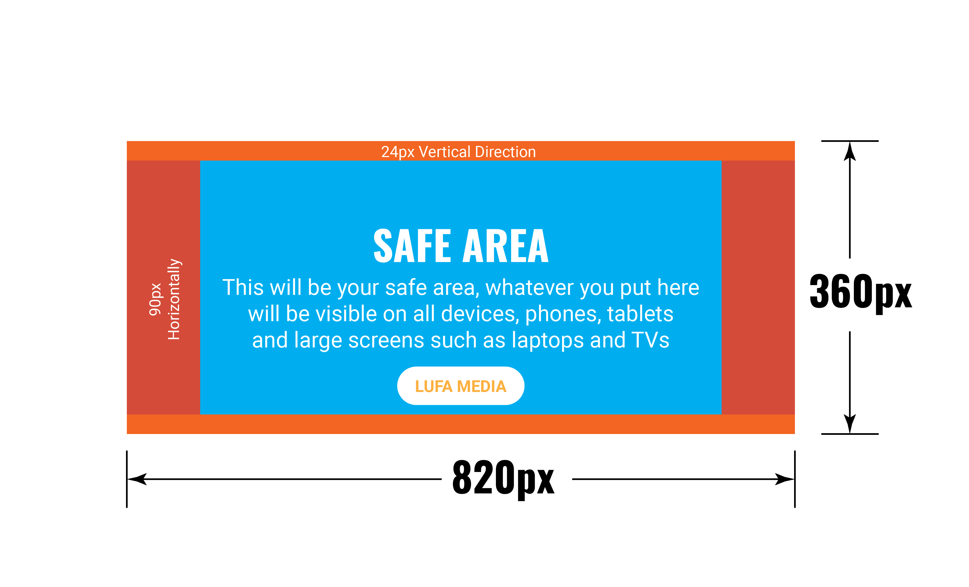
Dimensions for facebook cover photos

Slide 12
We will learn more about dimension in the future, giving focus on the following
Facebook event photo dimensions
Facebook group photo dimensions
Facebook story photo dimensions
Facebook video reels dimensions

Slide 13
Practical
We will now move on to facebook and create our Facebook business pages
So take out your laptops, or your phones if you do not have a computer
Connect to the following WIFI Network
Name: Example
Password: Example

